Slide 1
Introduction of AI
Lab 4

Slide 2
Introduction to BFS
Breadth-First Search (BFS) is a fundamental algorithm for traversing or searching through graph data structures. It explores nodes level by level, making it effective for finding the shortest path in unweighted graphs.

Slide 3
How BFS Works
The algorithm starts from a source node, visits all its neighboring nodes, and then continues to visit the neighbors of those nodes, ensuring each node is visited exactly once.

Slide 4
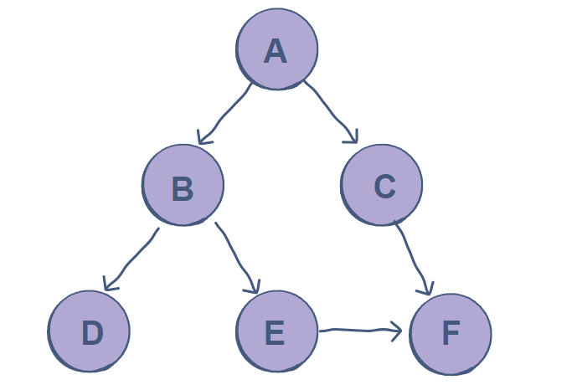
Ex 1
Implement The Next Graph using BFS Algorithm

Slide 5
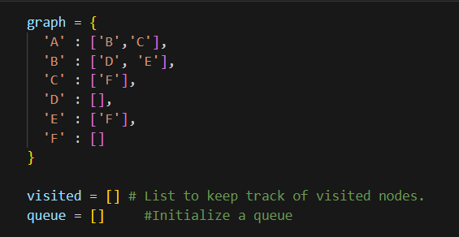
Exercise 1
Graph Structure:
This dictionary represents the adjacency list for the graph.
Each key represents a node, and each value is a list of its direct neighbors.
Setup:
visited: Tracks nodes already processed.
queue: Helps with node processing order.

Slide 6

Exercise 1
Function Setup:
bfs(visited, graph, node): Initializes BFS traversal from node.
Adds node to visited and queue.
Initial State:
Only the start node is in visited and queue.

Slide 7
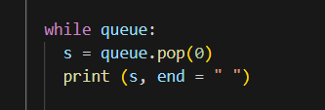
Exercise 1
Traversal Process:
While queue has elements, the function dequeues the
front node s.
Prints s to show traversal order.

Slide 8
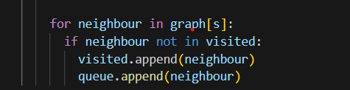
Exercise 1
Neighbor Exploration:
For each neighbour of s, if neighbour hasn’t been visited, it’s marked as visited and added to queue.
This ensures each level of neighbors is processed before moving deeper.

Slide 9
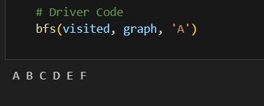
Exercise 1
Start from 'A'.
Iteration 1: Dequeue A, enqueue B, C.
Iteration 2: Dequeue B, enqueue D, E.
Iteration 3: Dequeue C, enqueue F.
Final Order: A B C D E F

Slide 10
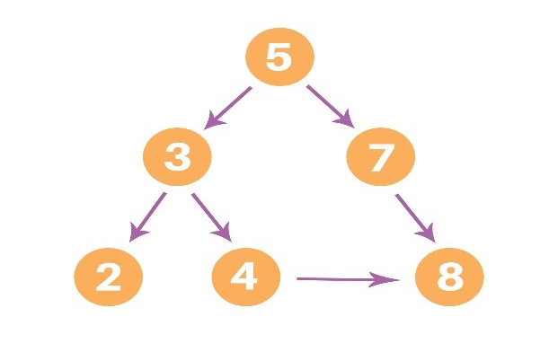
Ex 2
Solve The Following graph using BFS Algorithm

Slide 11
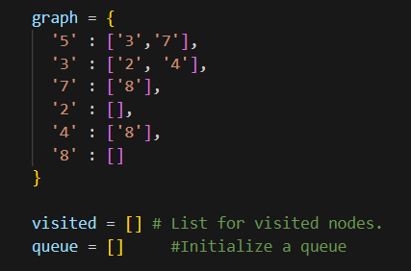
Exercise 2
Graph Structure:
Similar to Code 1 but uses numbers for nodes.
Helps to represent graphs with integer-based labels.
Initialization:
visited and queue lists are initialized as empty

Slide 12
Exercise 2
Initial Setup:
Adds the start node node to visited and queue.

Slide 13
Exercise 2
Graph Structure:
Similar to Code 1 but uses numbers for nodes.
Helps to represent graphs with integer-based labels.
Initialization:
visited and queue lists are initialized as empty

Slide 14

Exercise 2
Node Processing:
While the queue is not empty, it dequeues the front node m.
Prints each dequeued node to show traversal order.

Slide 15
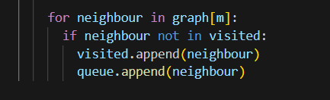
Exercise 2
Neighbor Exploration:
For each neighbour of m, checks if it’s unvisited.
Unvisited neighbors are marked and enqueued.

Slide 16
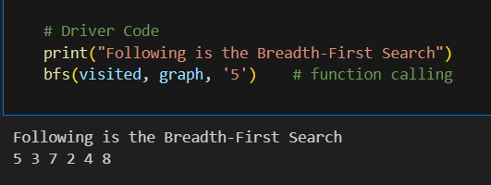
Exercise 2
Execution Steps:
Start from 5.
Iteration 1: Dequeue 5, enqueue 3, 7.
Iteration 2: Dequeue 3, enqueue 2, 4.
Iteration 3: Dequeue 7, enqueue 8.
Final Order: 5 3 7 2 4 8

Slide 17
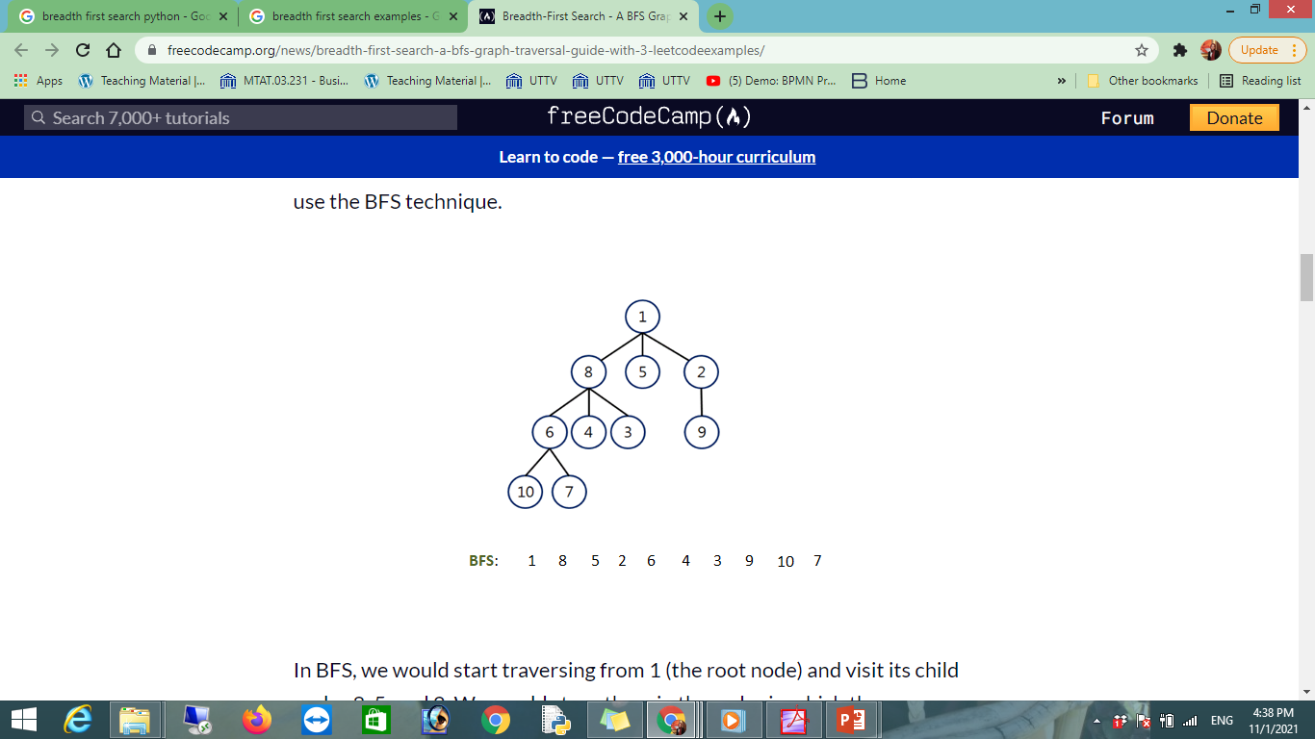

Slide 19
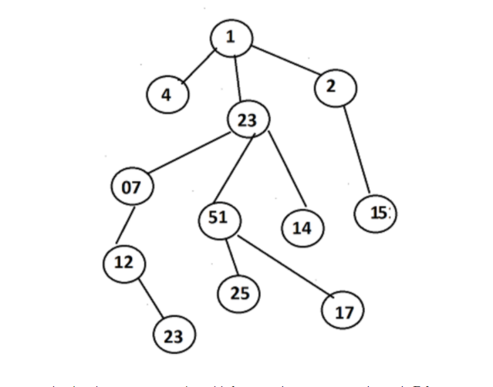

Slide 20
BFS Steps
1. Initialize a queue with the source node.
2. Mark the source node as visited.
3. While the queue is not empty:
- Dequeue a node.
- For each unvisited neighbor, enqueue it and mark it as visited.

Slide 21
LAB 5
Uniform cost search

Slide 22
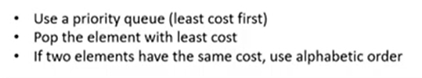
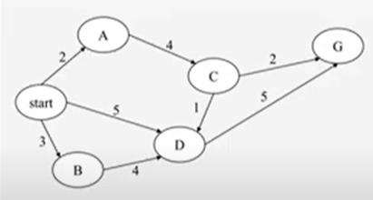
Uniform Cost Search

Slide 23
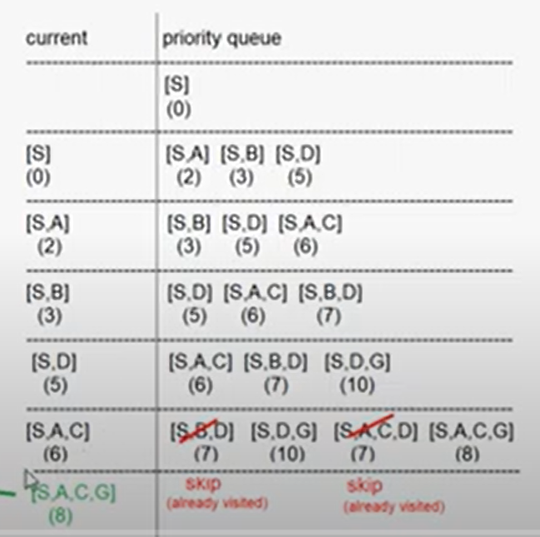
Uniform Cost Search

Slide 24
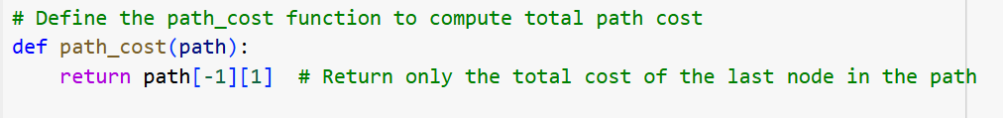
Uniform Cost Search

Slide 25
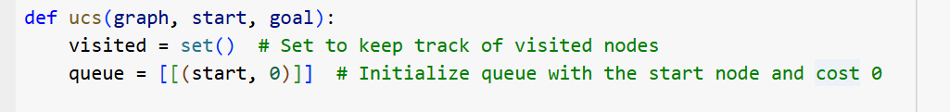
Uniform Cost Search

Slide 26
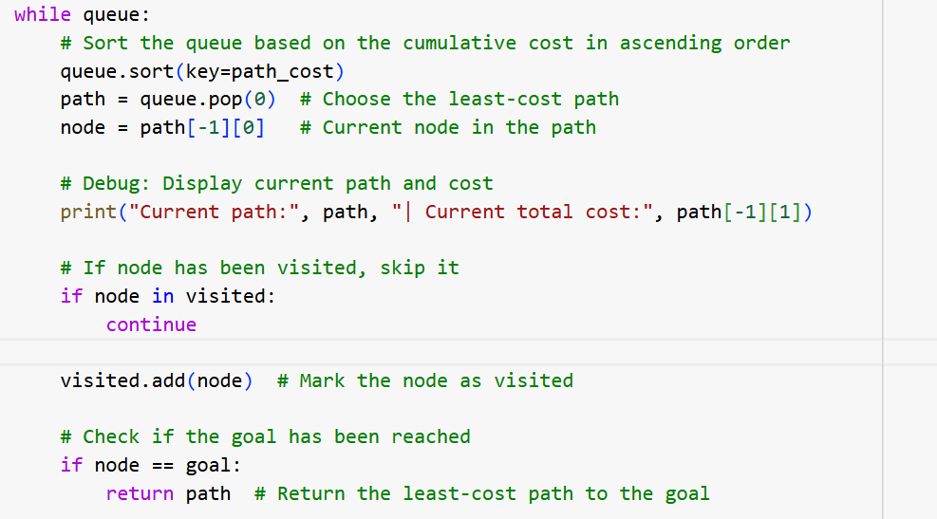
Uniform Cost Search

Slide 27
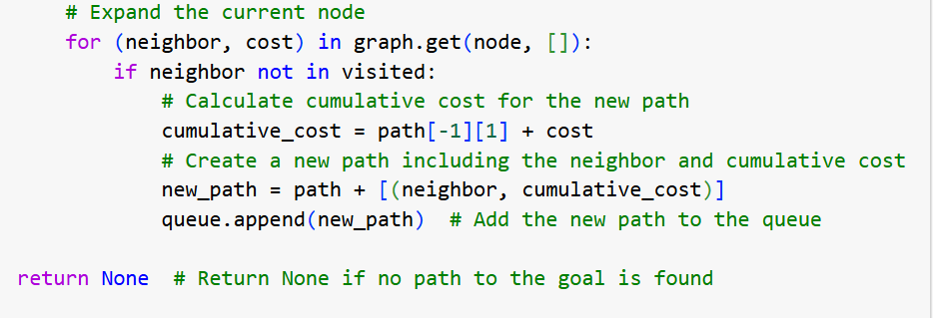
Uniform Cost Search

Slide 28
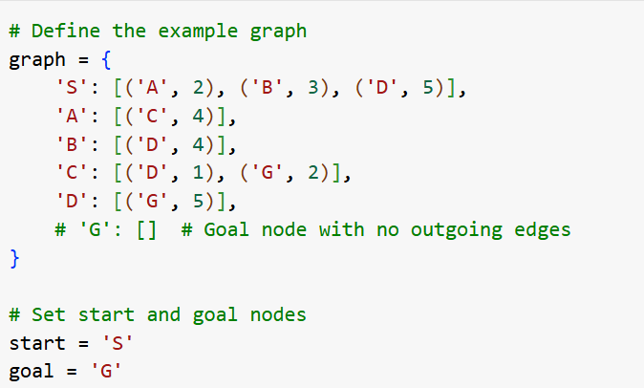
Uniform Cost Search

Slide 29
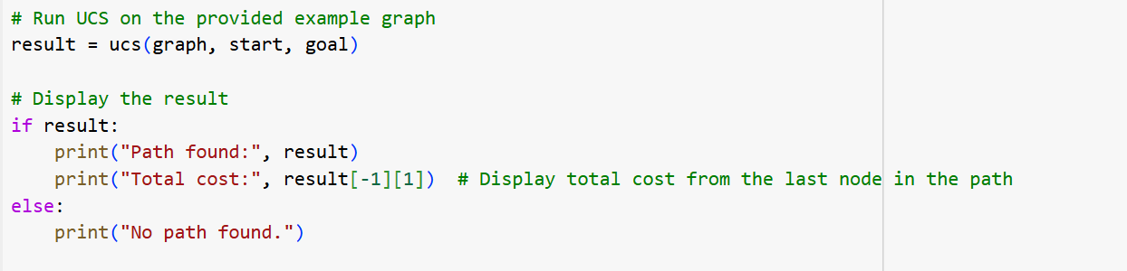
Uniform Cost Search

Slide 30
Another code for Uniform Cost Search

Slide 31
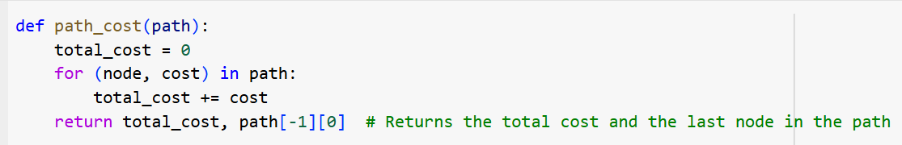
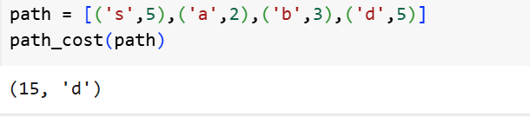
Uniform Cost Search

Slide 32
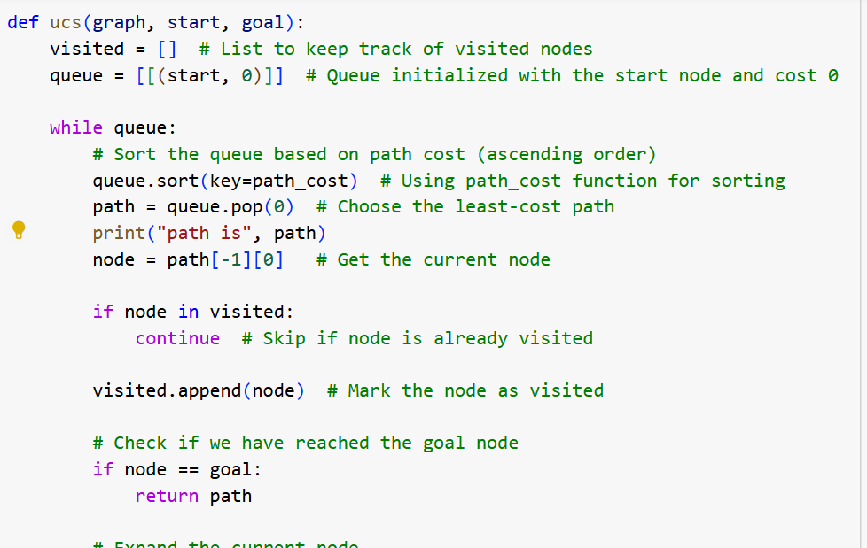
Uniform Cost Search

Slide 33
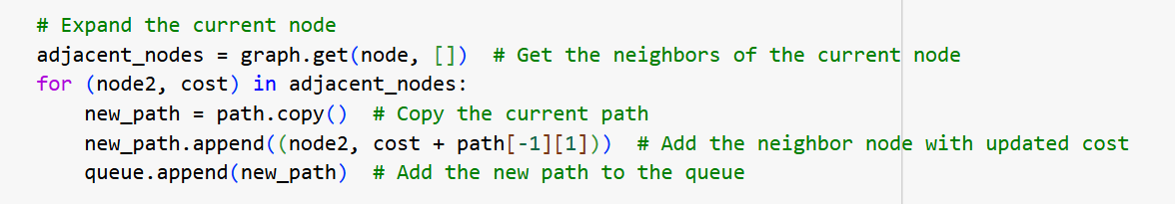
Uniform Cost Search

Slide 34
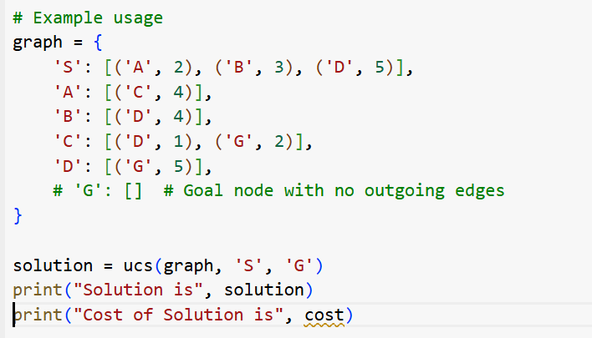
Uniform Cost Search

